Slide 1
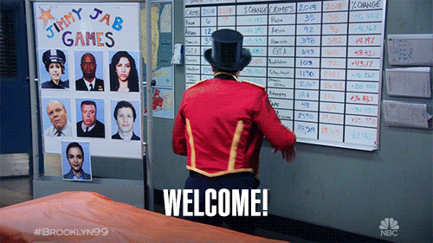
Welcome !!

Slide 2
NLP
Natural Language Processing Class – 14

Slide 3
Quick Recap
Python Done
NLP- Data Preprocessing (Tokenization, Stopwords lemmatization/ Stemming)
We saw Vectorizing (Count-Vectorizer, Tf-Idf Vectorizer)
Sentiment Analysis (Dictionary based)
Basics of Machine Learning(classification/Regression/Clustering)
Clustering & Classification
Recap & Project Discussion
A Look at the flows for different use case

Slide 4
What we will do today
Word2Vec
Just Recap & Project Discussion
Selection of a Dataset for Projects

Slide 5
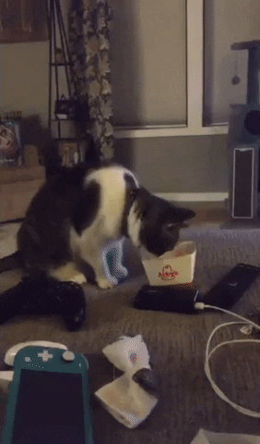
That’s it

Slide 6

Let’s go !!

Slide 7

Thanks

Slide 8

Will see you in the next one

